Slide 1
Planned Work at
Global Seismograph Network (GSN)
Seismic Station JTS
(Las Juntas de Abangares)
Observatorio Vulcanológico y Sismológico de Costa Rica
(OVSICORI), Heredia, Costa Rica, 30 January 2019
Carl Ebeling, IGPP, SIO, University of California, San Diego
INTERNATIONAL DEPLOYMENT OF ACCELEROMETERS (IDA)

Slide 2
(41)
(~100)
(12)

Slide 3
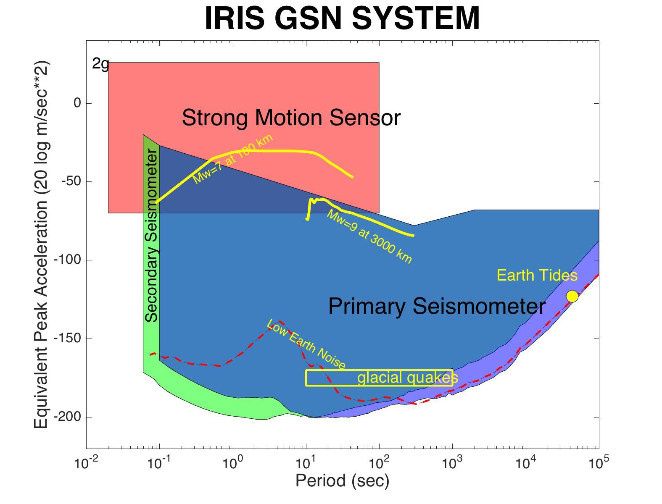
GSN requirement: Record on scale all seismic waves from Mw=9 earthquake at 3000 km

Slide 4
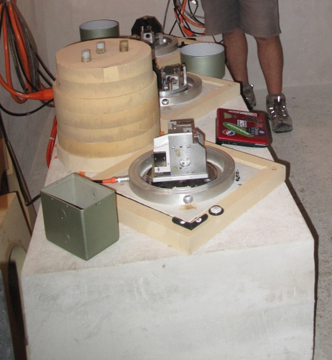
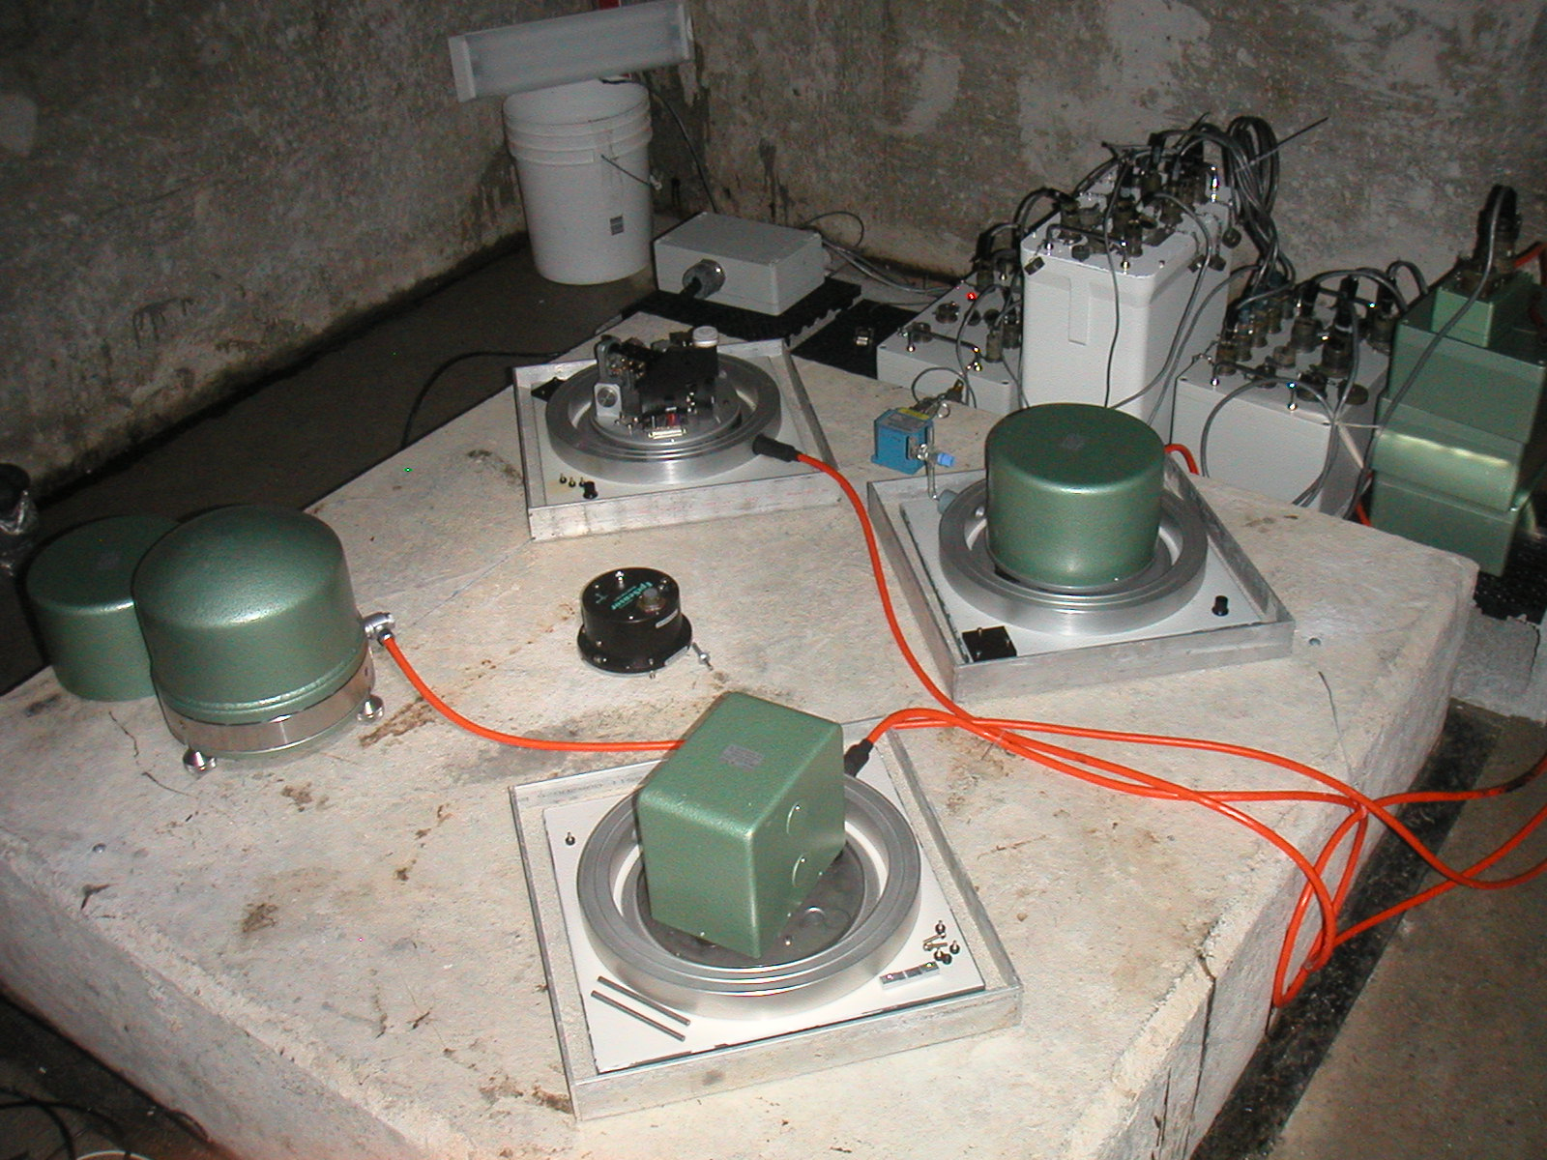
Primary and Secondary Sensors at GSN Vault Stations
UOSS (United Arab Emirates)
STS-1s and STS-2
JTS: STS-1s and STS-2 (not shown)

Slide 5
Aging STS-1 Seismometers
Streckeisen STS-1Z/VBB and STS-1H/VBB seismometers are experiencing increasing problems everywhere due to age.
At prime, exceptional performance. But now:
No longer manufactured
Spare parts not available
Replacements only via cannabalism
Upkeep and maintenance in turn more challenging
JTS: STS-1s and STS-2 (not shown)

Slide 6
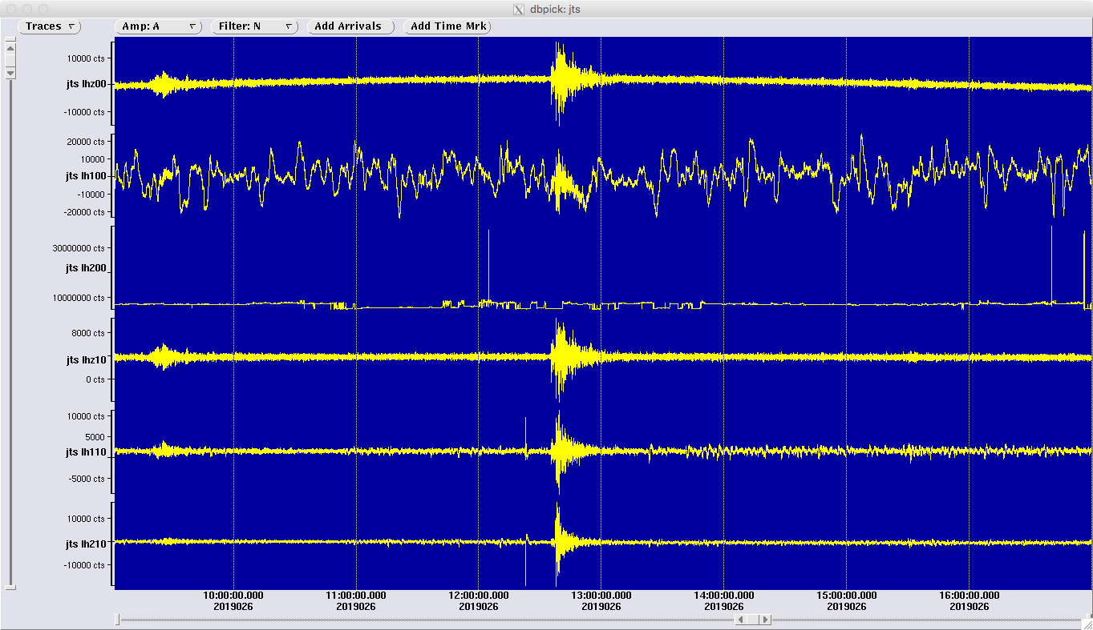
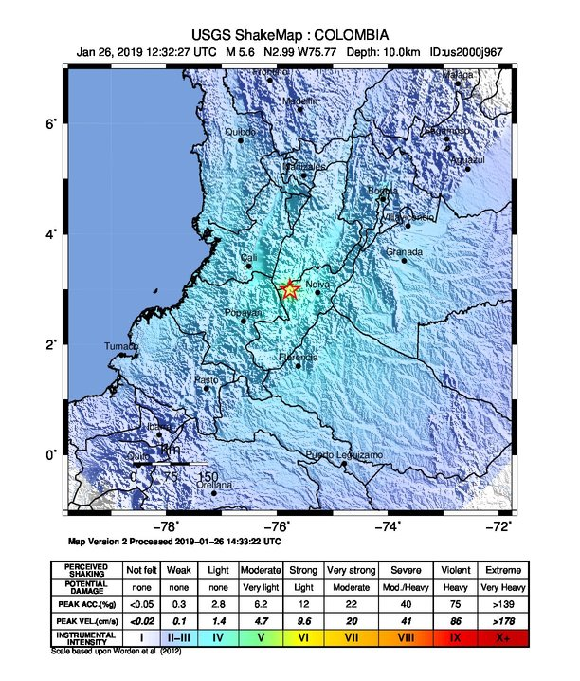
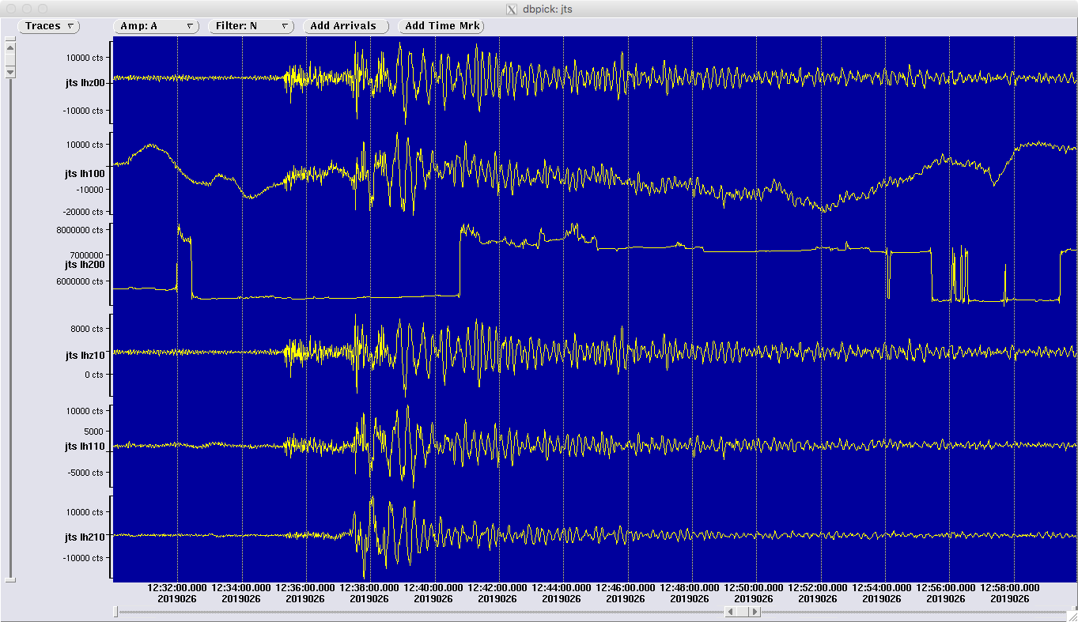
STS-1 Seismometers: Aging at JTS, too
STS-1 V
STS-1 H1
STS-1 H2
STS-2.5 Z
STS-2.5 H1
STS-2.5 H2
4-hour-long record
2018-026 12:32 M5.6 13 km WNW of Santa Maria, Colombia
(delta = 11.7 deg.)
30-minute-long record

Slide 7
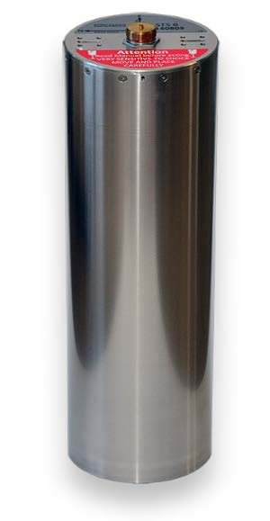
LP (360 s) Replacements for STS-1 Seismometers
Few low-noise very long-period (360 s)seismometers:
Heavy investment in R & D
Testing difficult
Significant engineering and manufacturing challenges
High cost but low demand
Solution:
Install borehole-package STS-6A in cored hole in vault
Sensitivity: 2 x 600 V/m/s
Response: Flat to ground velocity, 2.78 mHz to 50 Hz
Package: 153 mm diameter x 610 mm long (6 in dia x 24 in)
Weight: 30 kg
Power draw: 0.9 W, max < 2 W
STS-6A

Slide 8
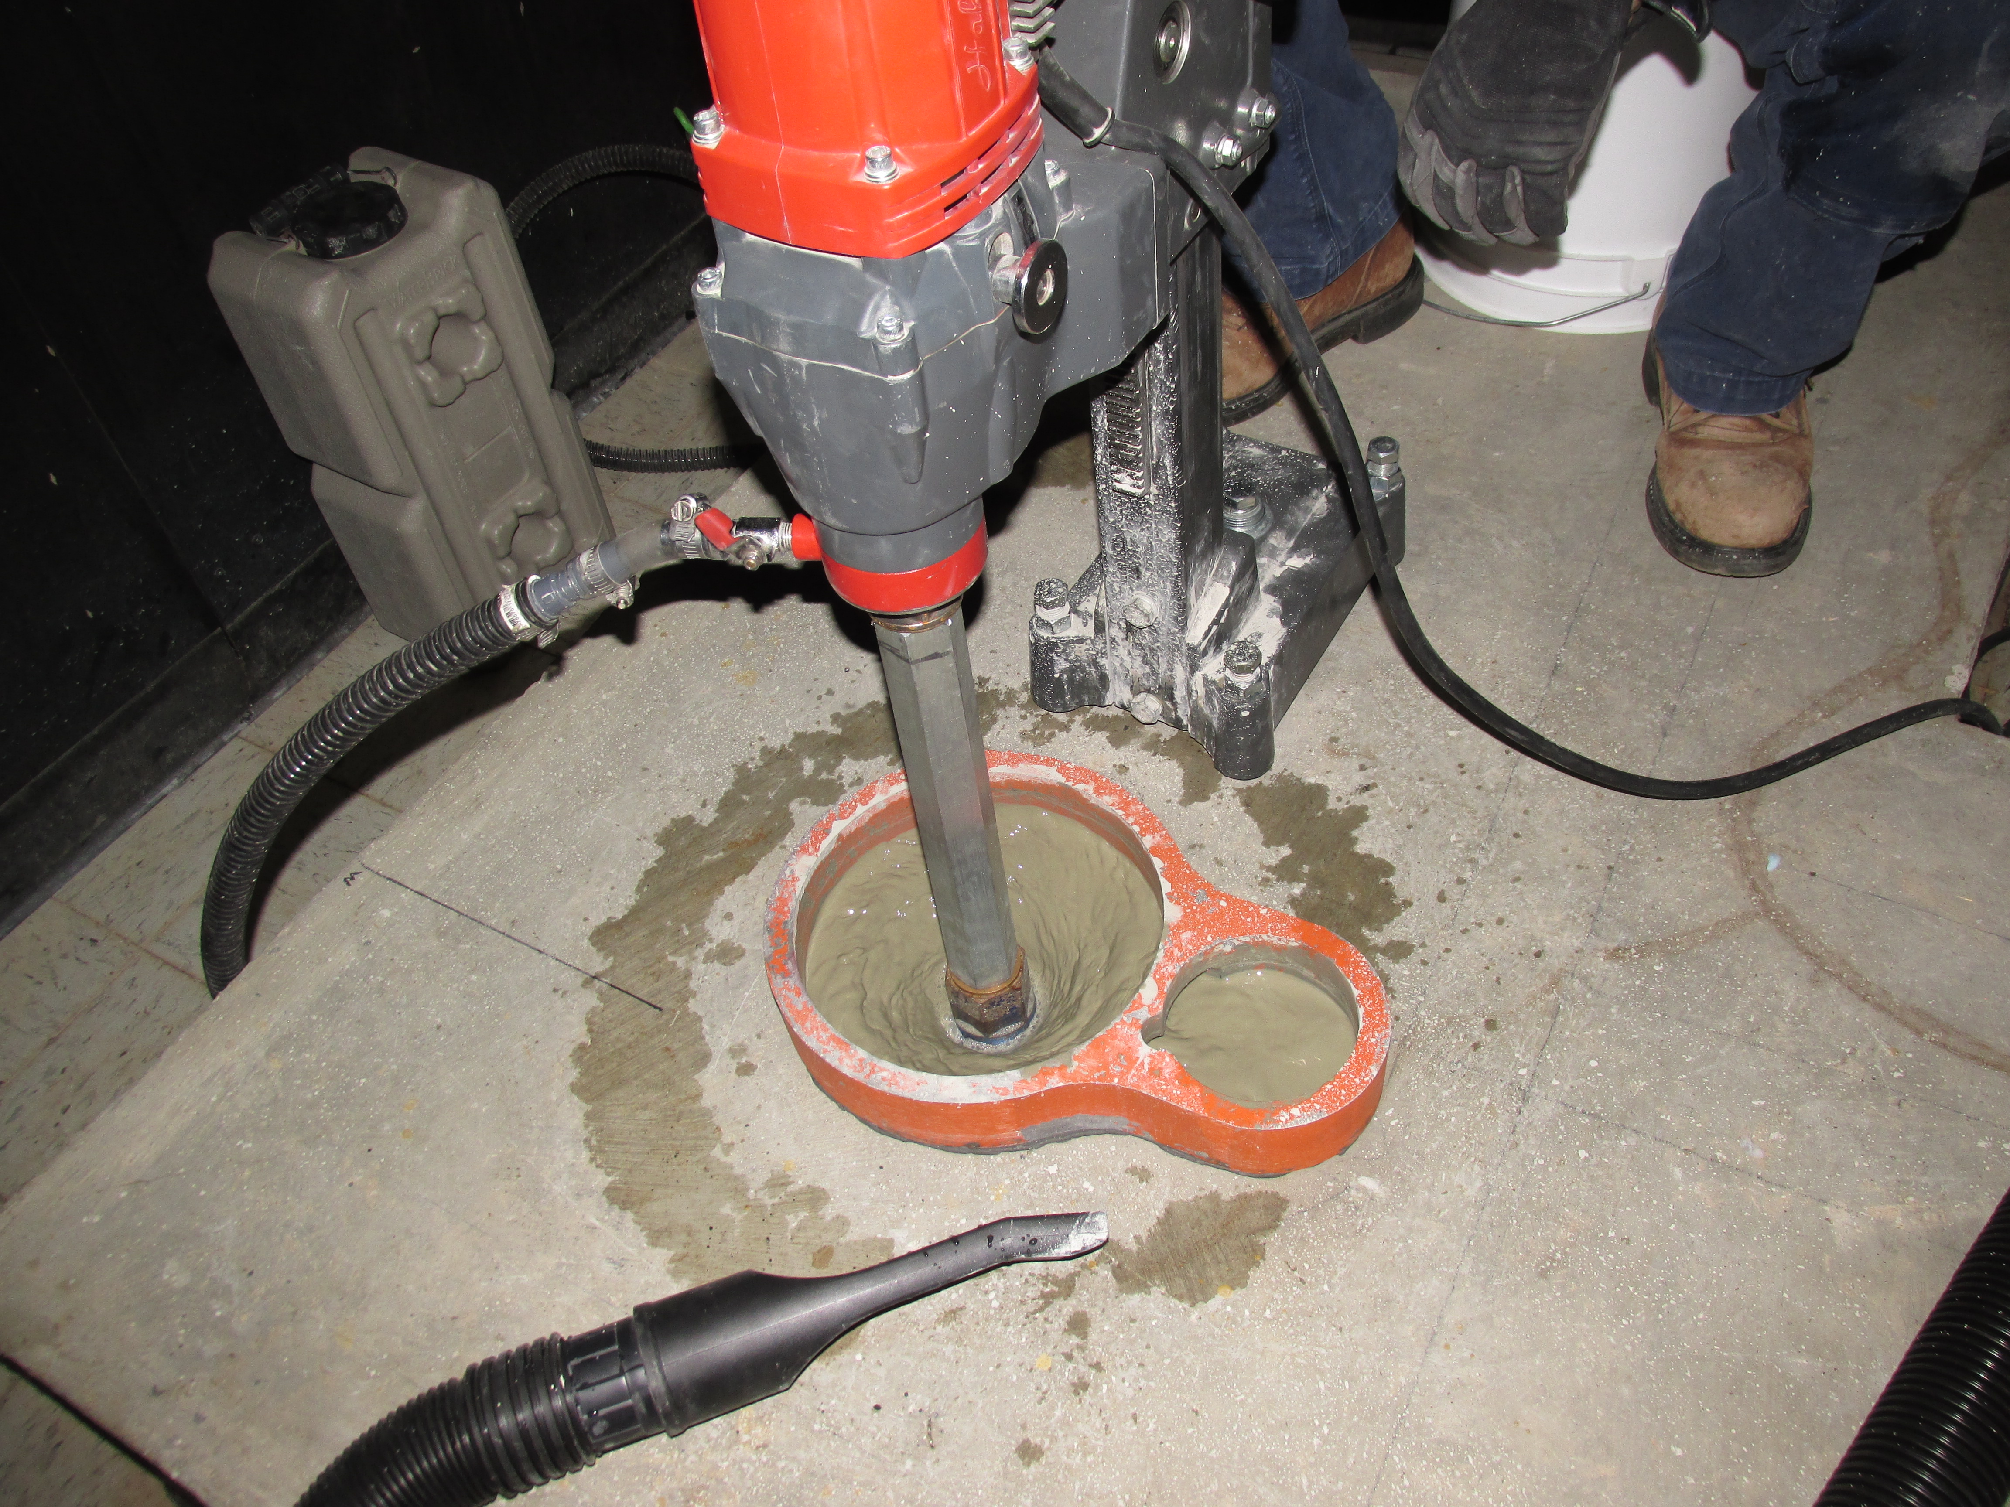
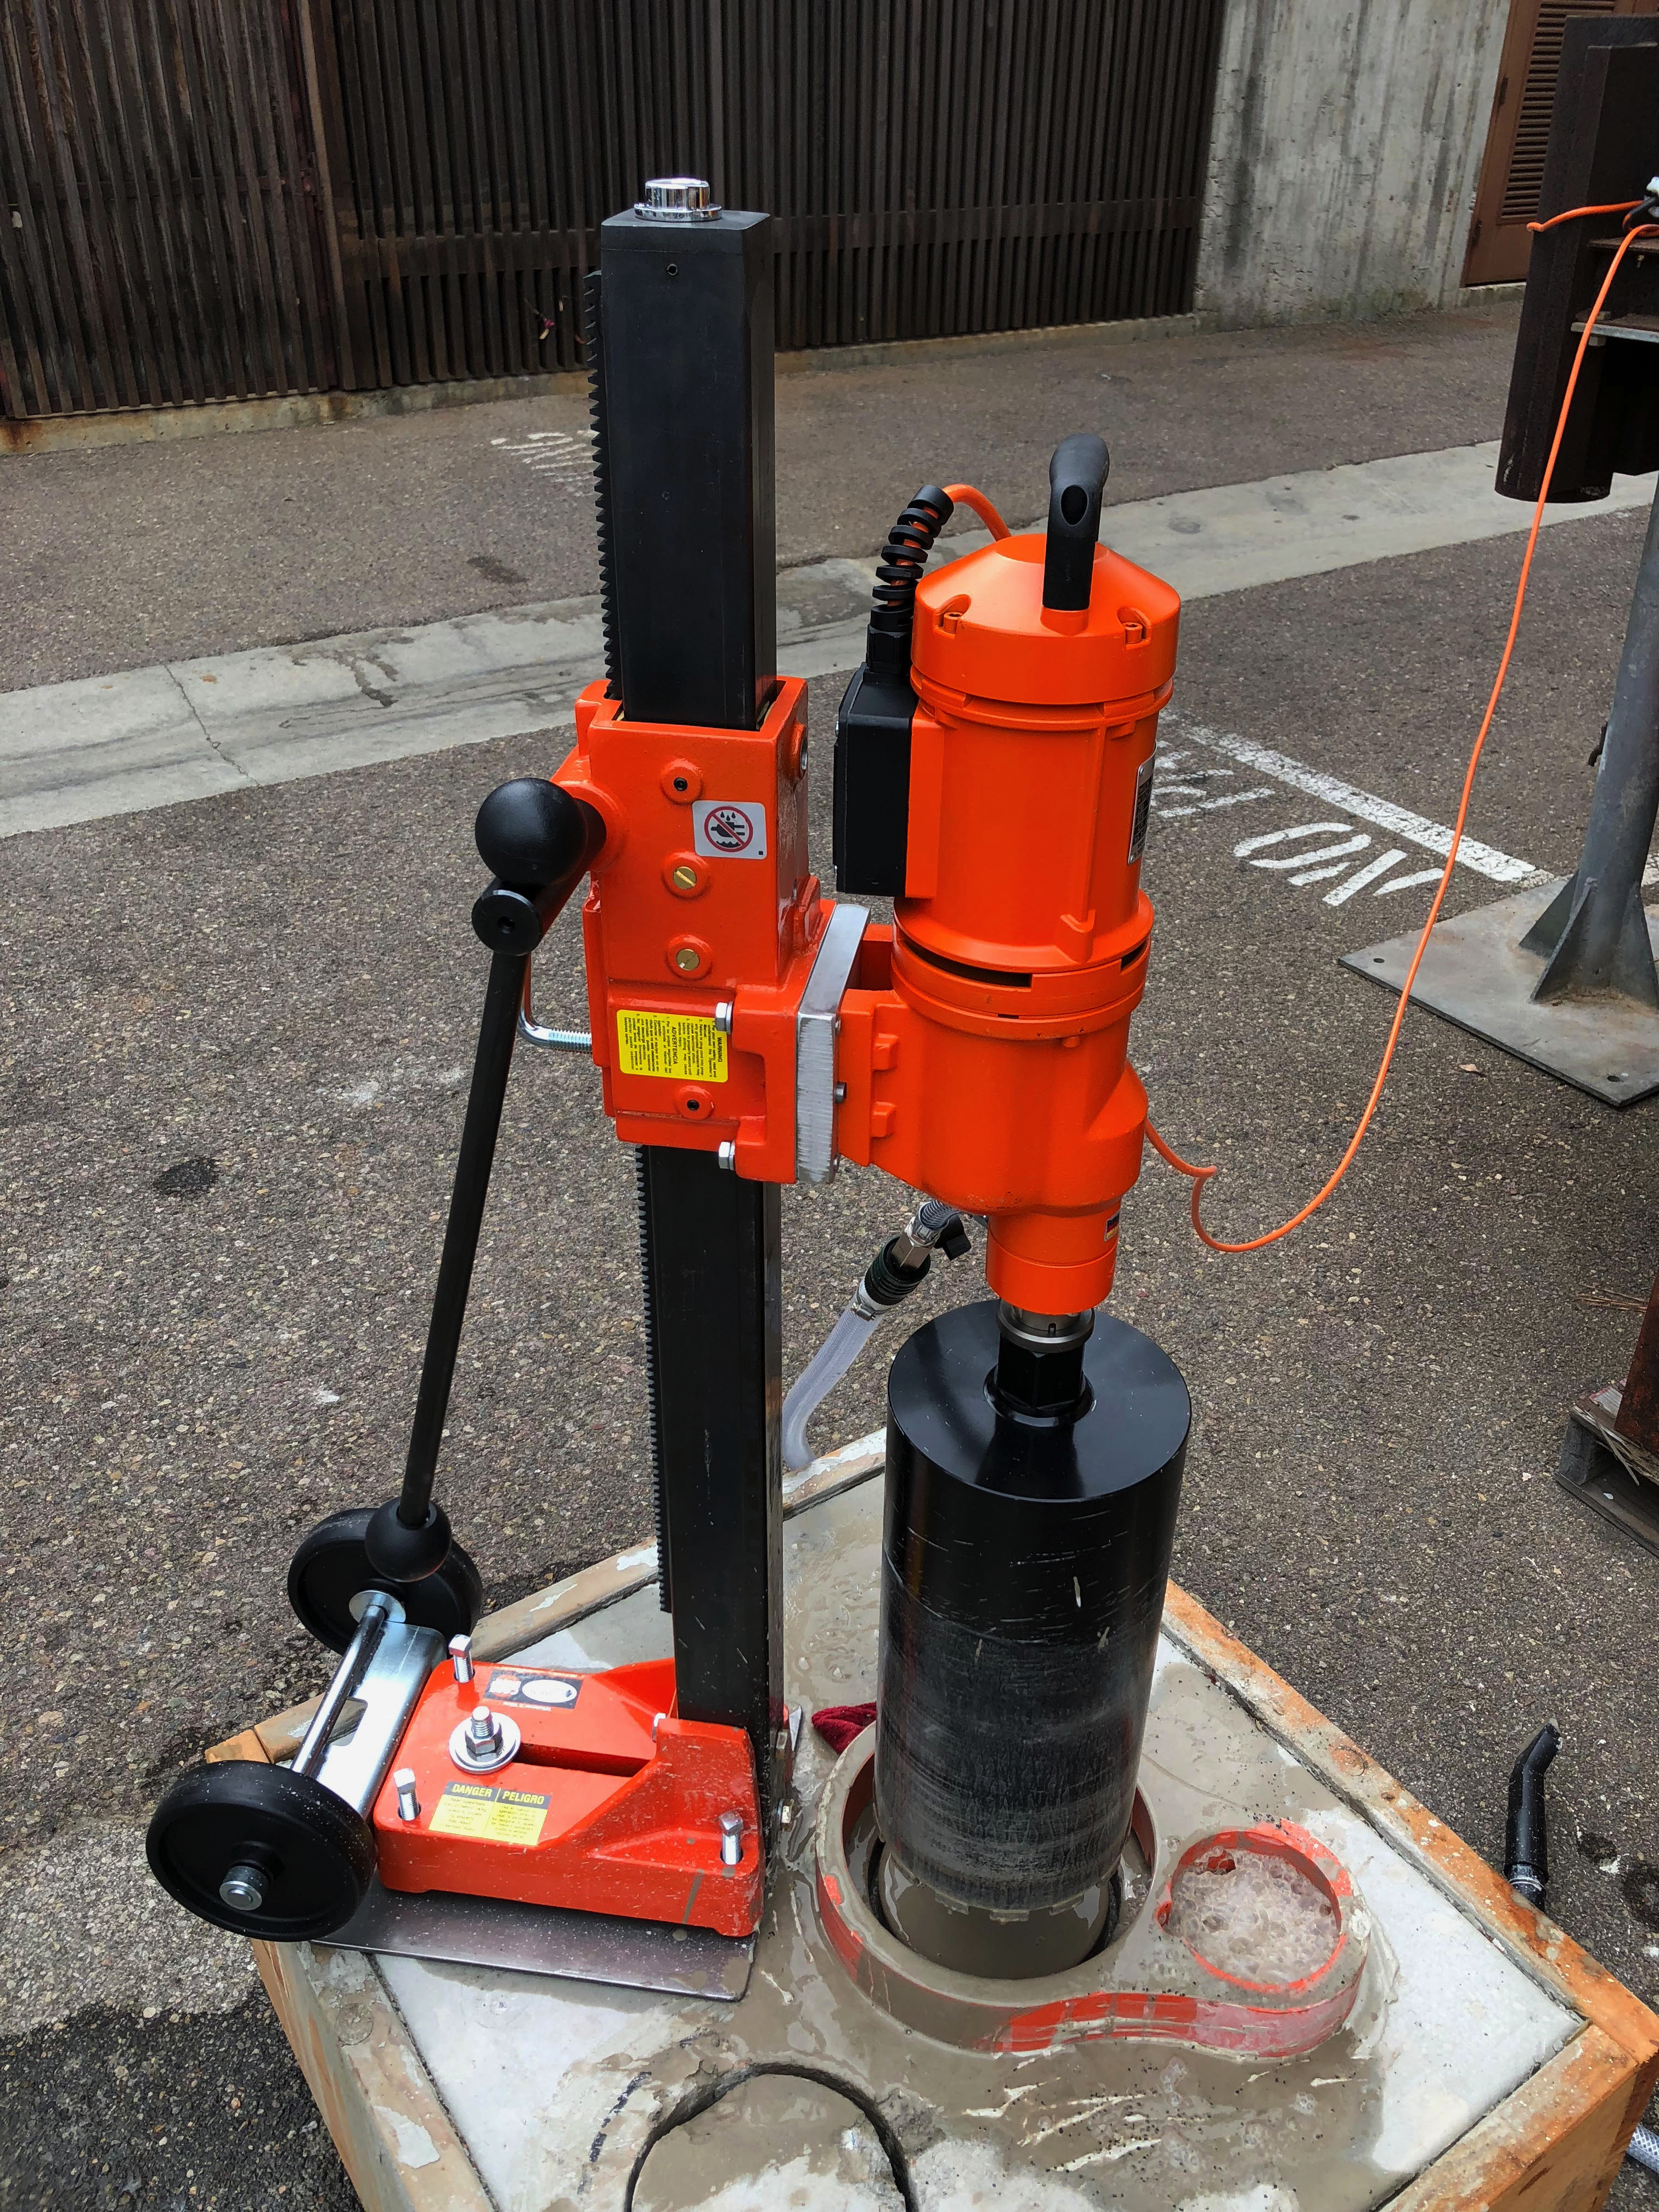
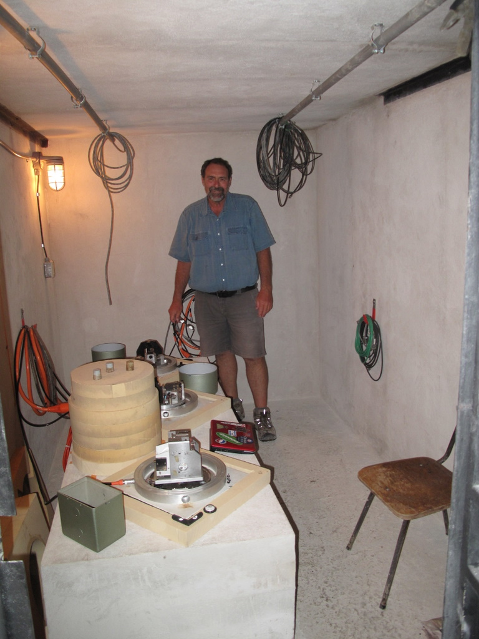
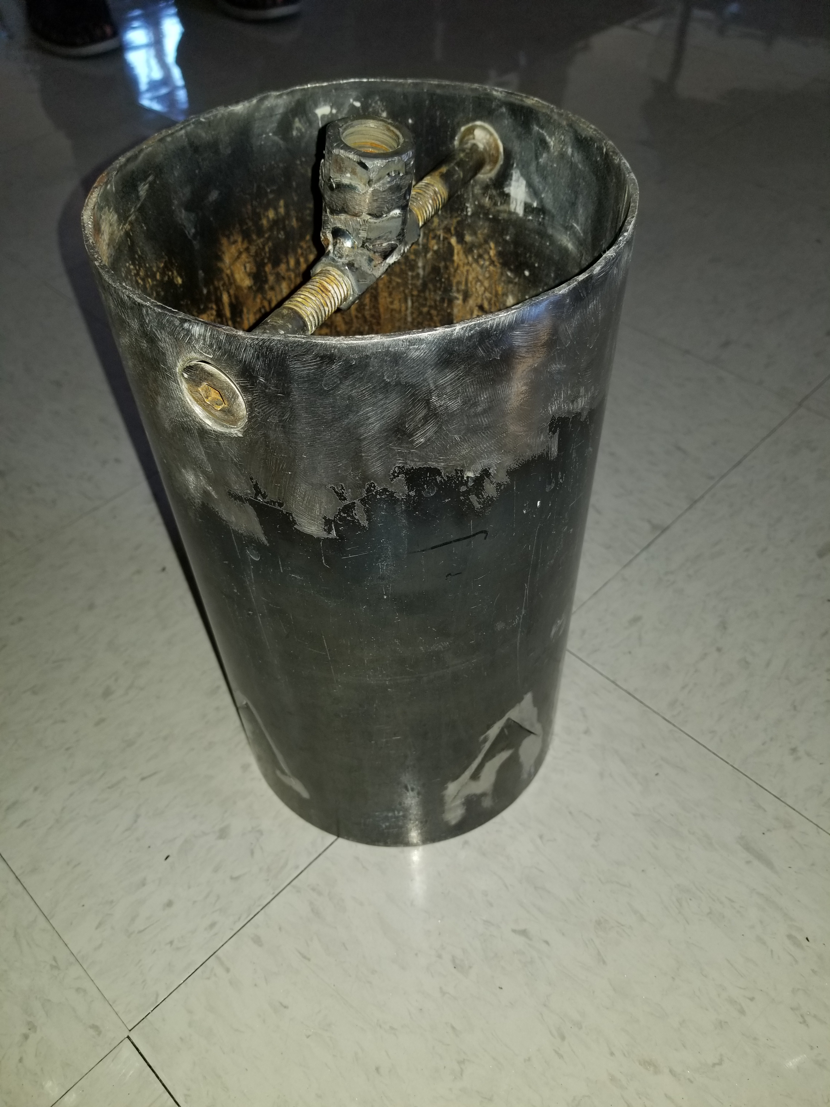
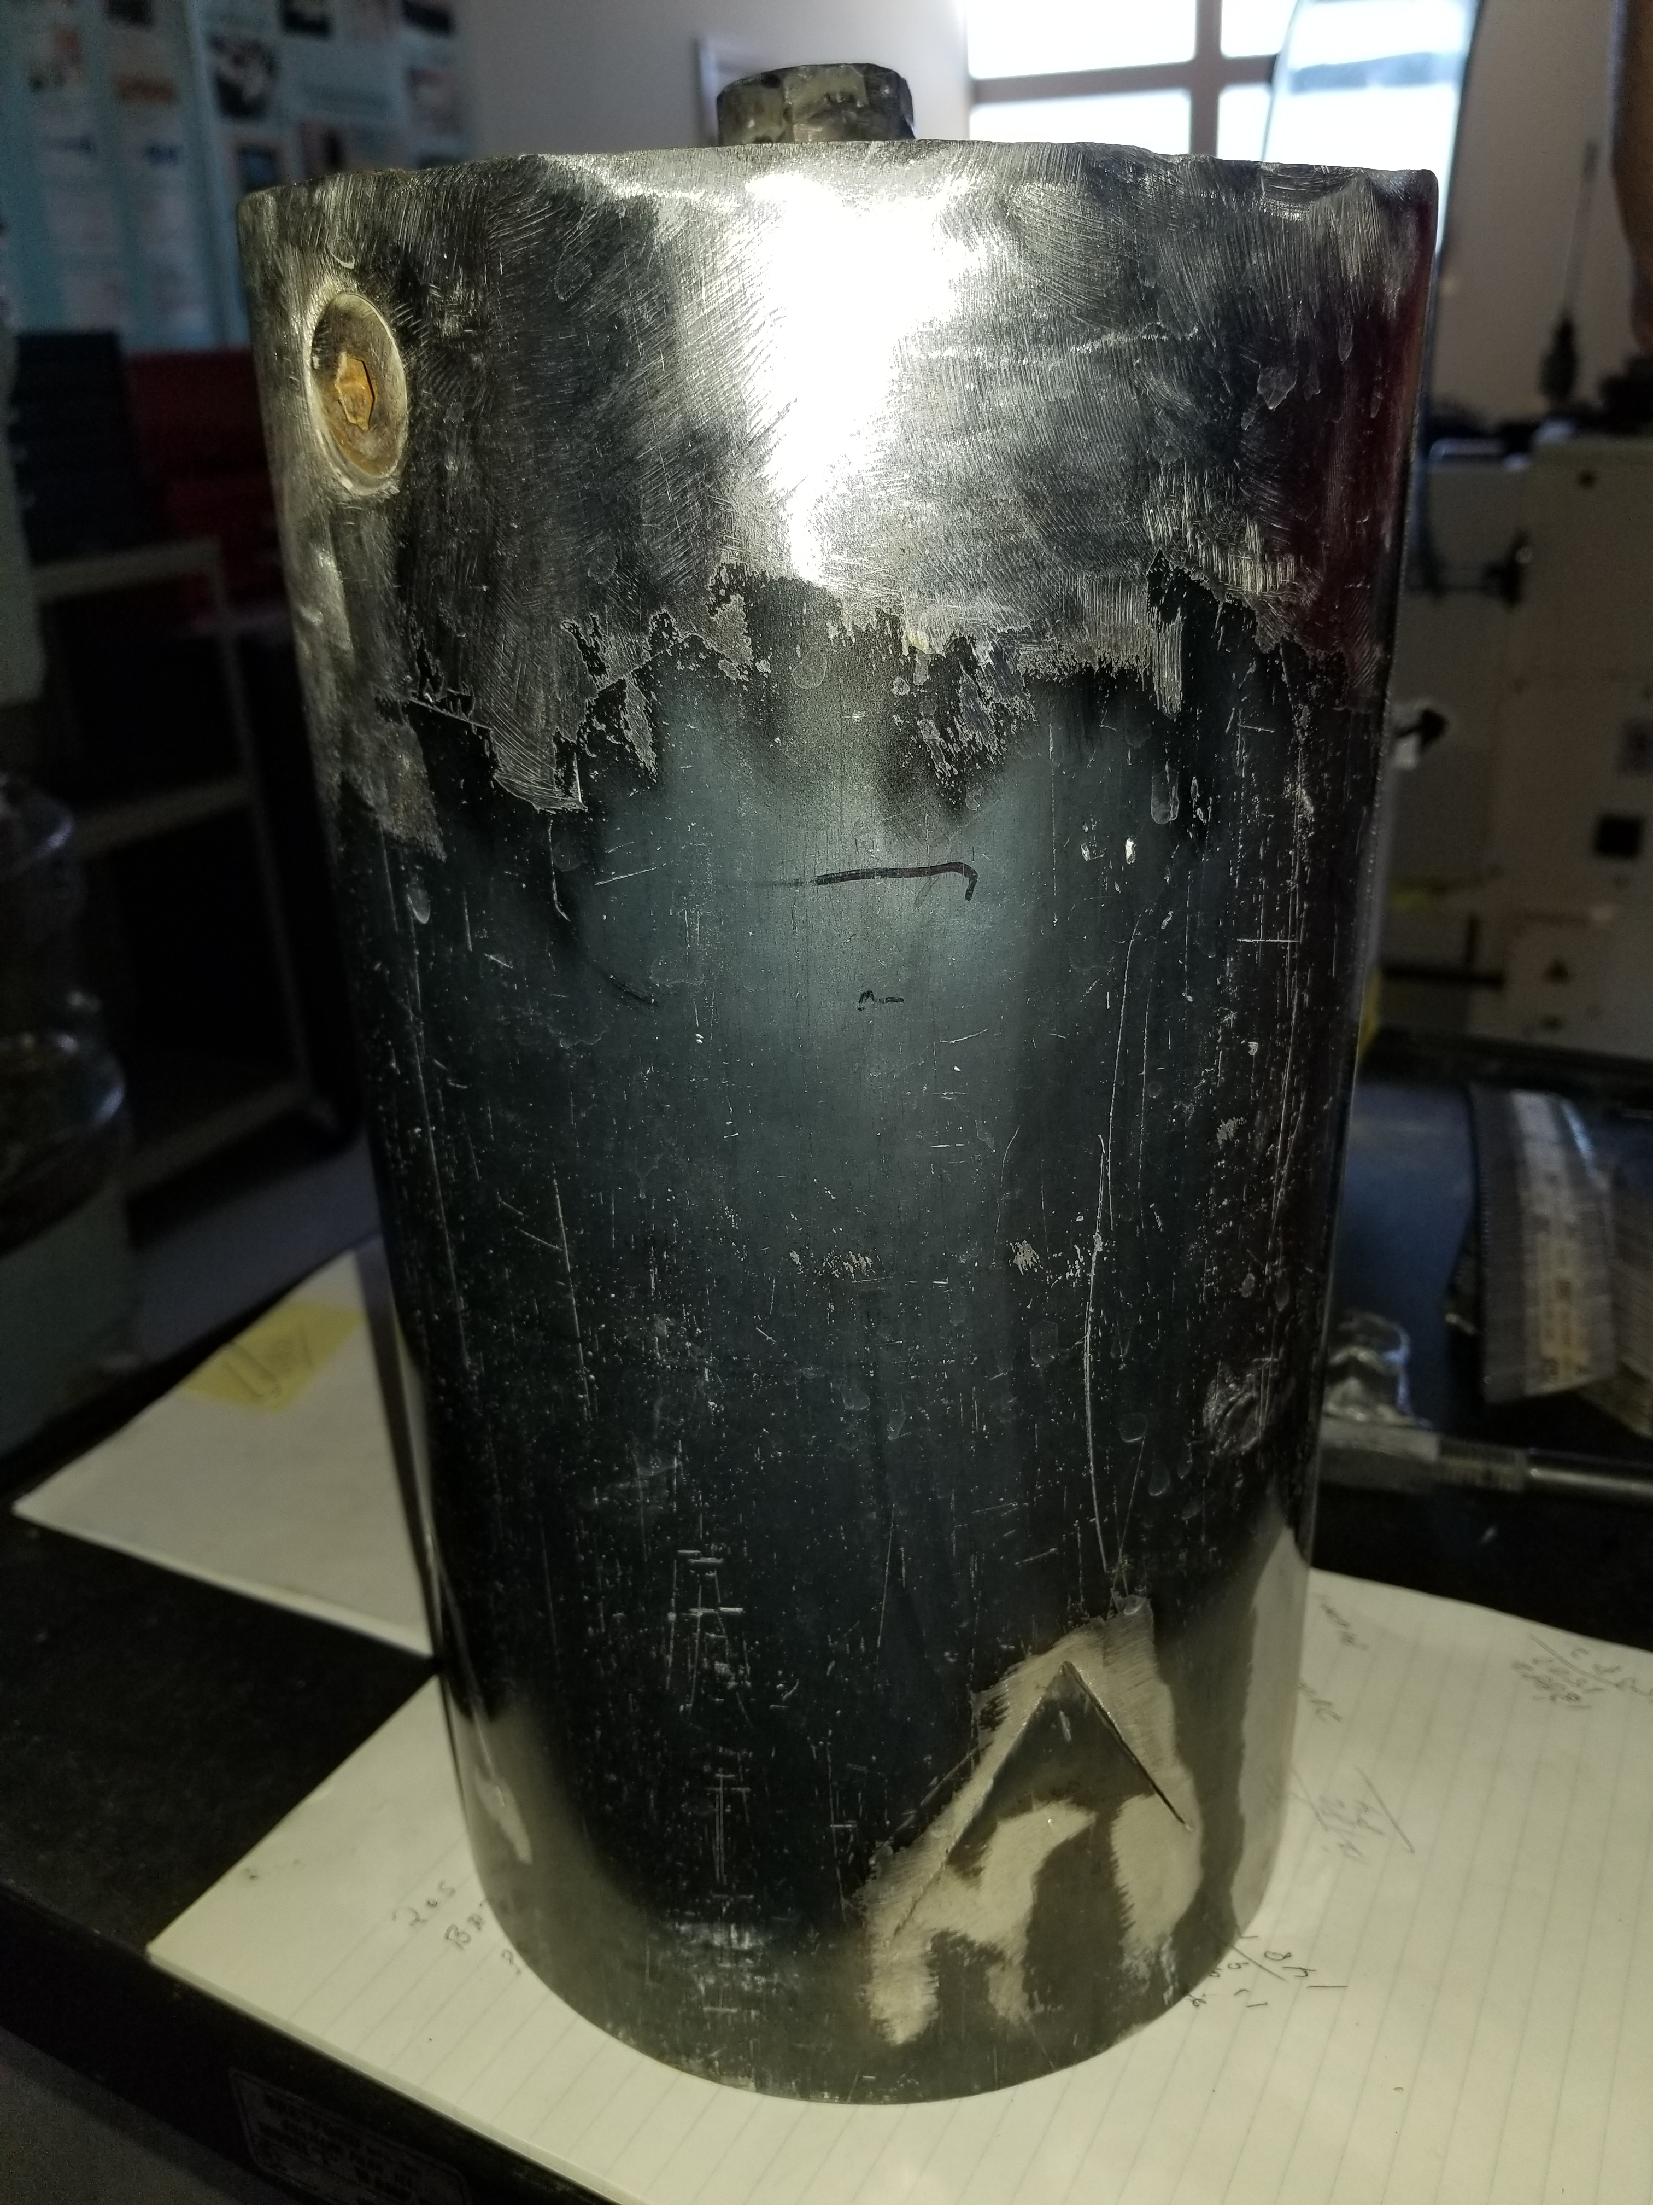
Core Drilling at JTS
Coring rig
Goal depth ~ 1m
~5-6 cm/h
Core extraction tool

Slide 9
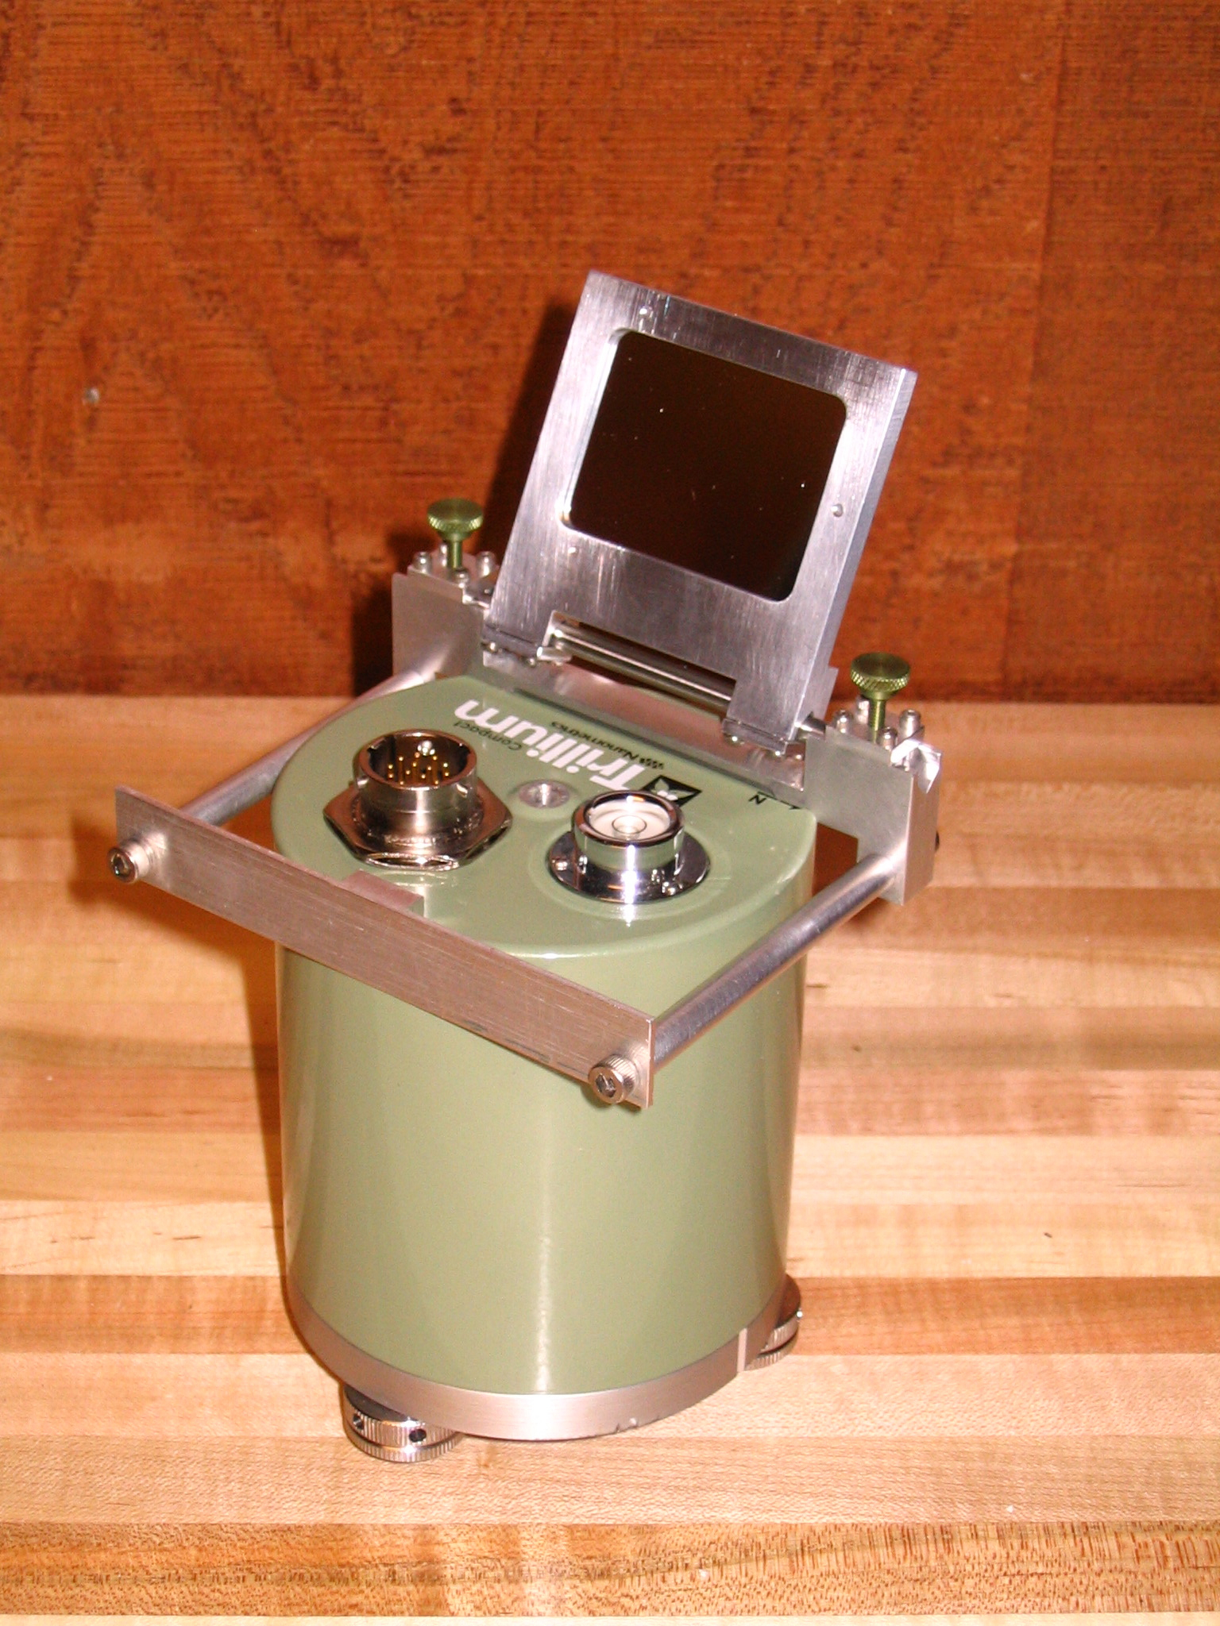
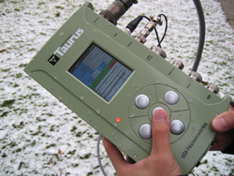
Determination of Seismometer Orientation
Elements of independent calibration/recording system are used to determine orientation of seismometer
Nanometrics Compact Trillium 120 and Taurus digitizer

Slide 10
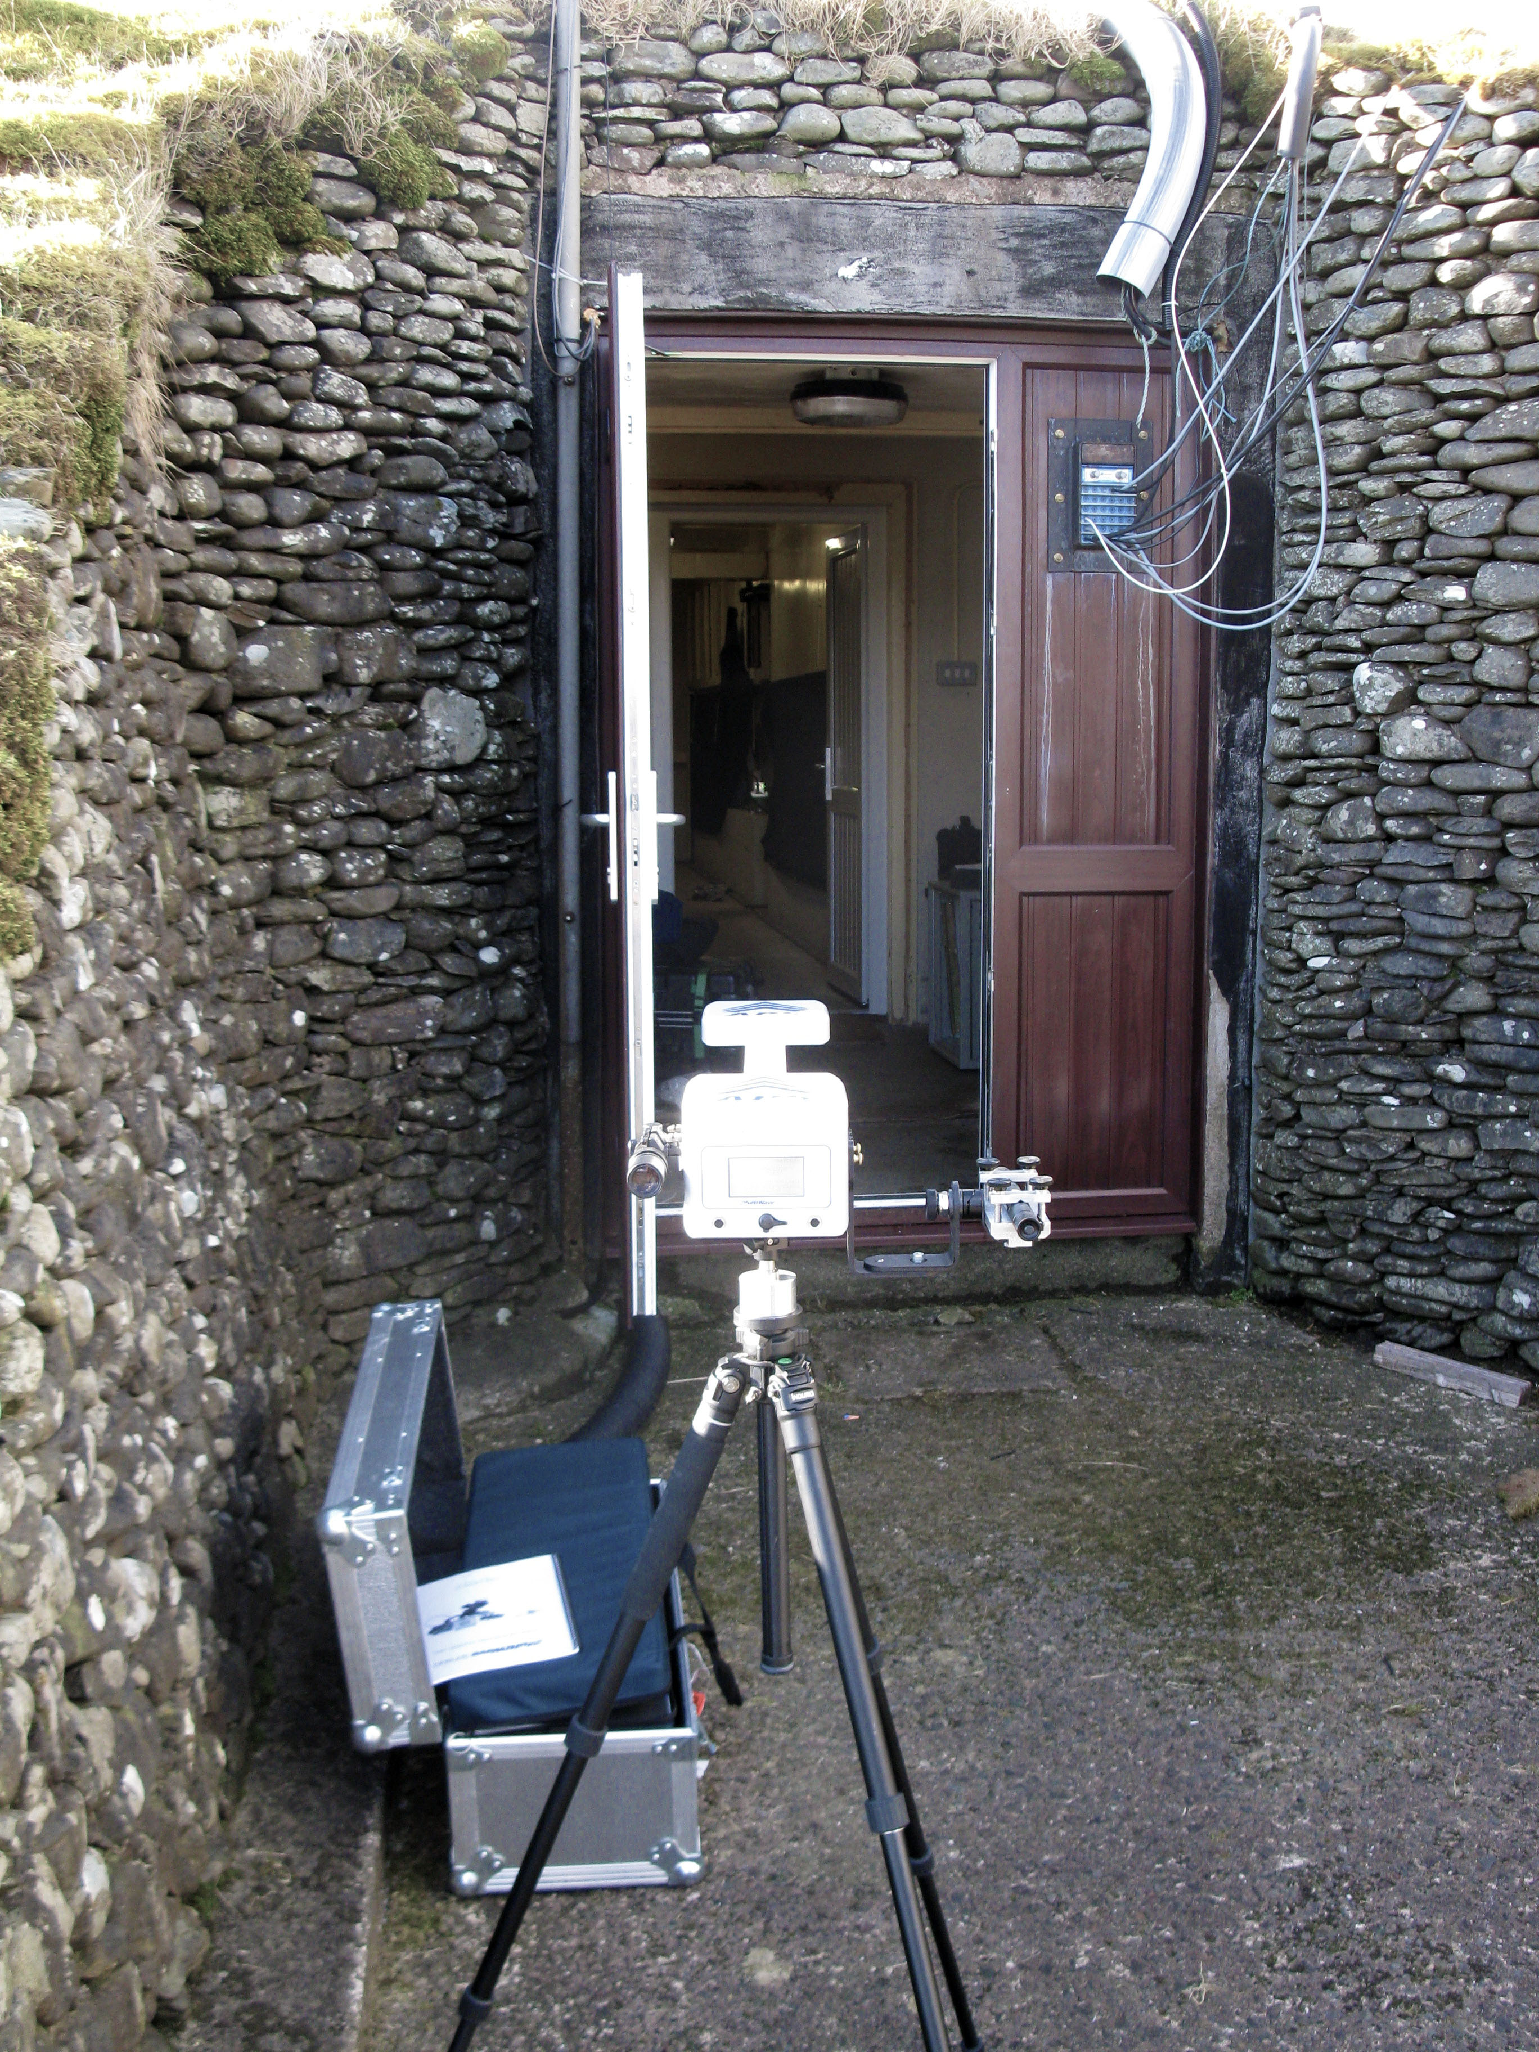
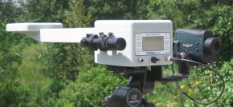
Determination of Seismometer Orientation
APS used to determine orientation of Compact Trillium

Slide 11
Determination of Seismometer Orientation
Determination of relative ampitude accurate to < 1 %
Determination of relative orientation accurate to < 1 deg
2+ hours of microseismic background noise usually sufficient for robust analysis

Slide 12
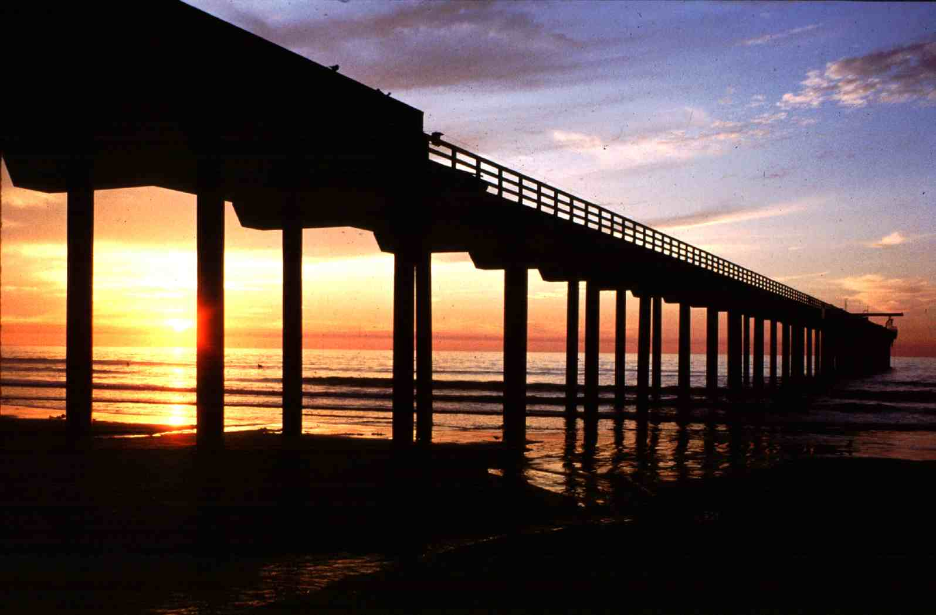
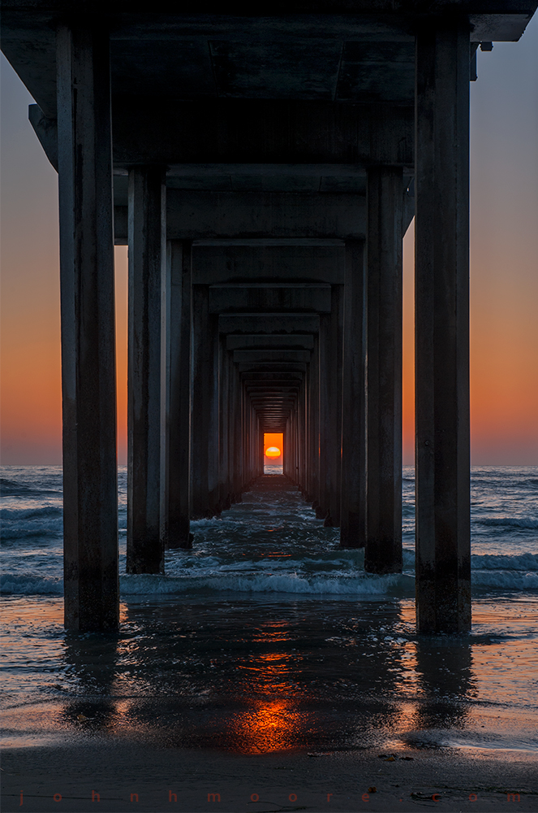
Thank you!
Pier at the Scripps Institution of Oceanography, UCSD

Slide 13
Thank you!
Pier at the Scripps Institution of Oceanography, UCSD

